Slide 1
Ranjan Ravi
Business Intelligence Engineer at Amazon
Previously, Data Scientist at Bayer

Slide 2
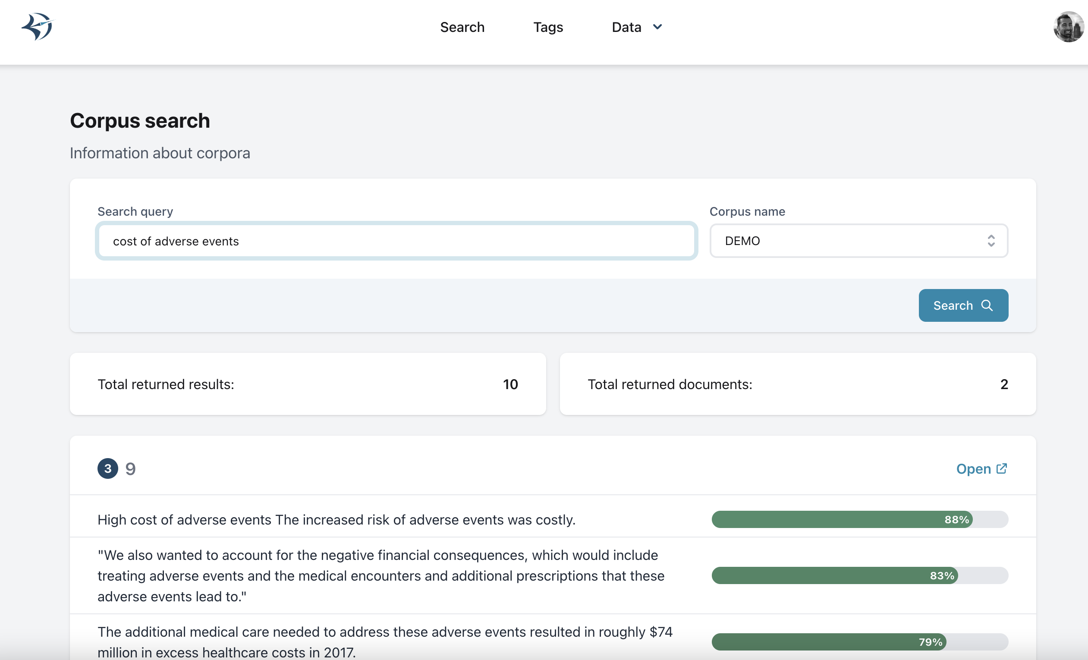
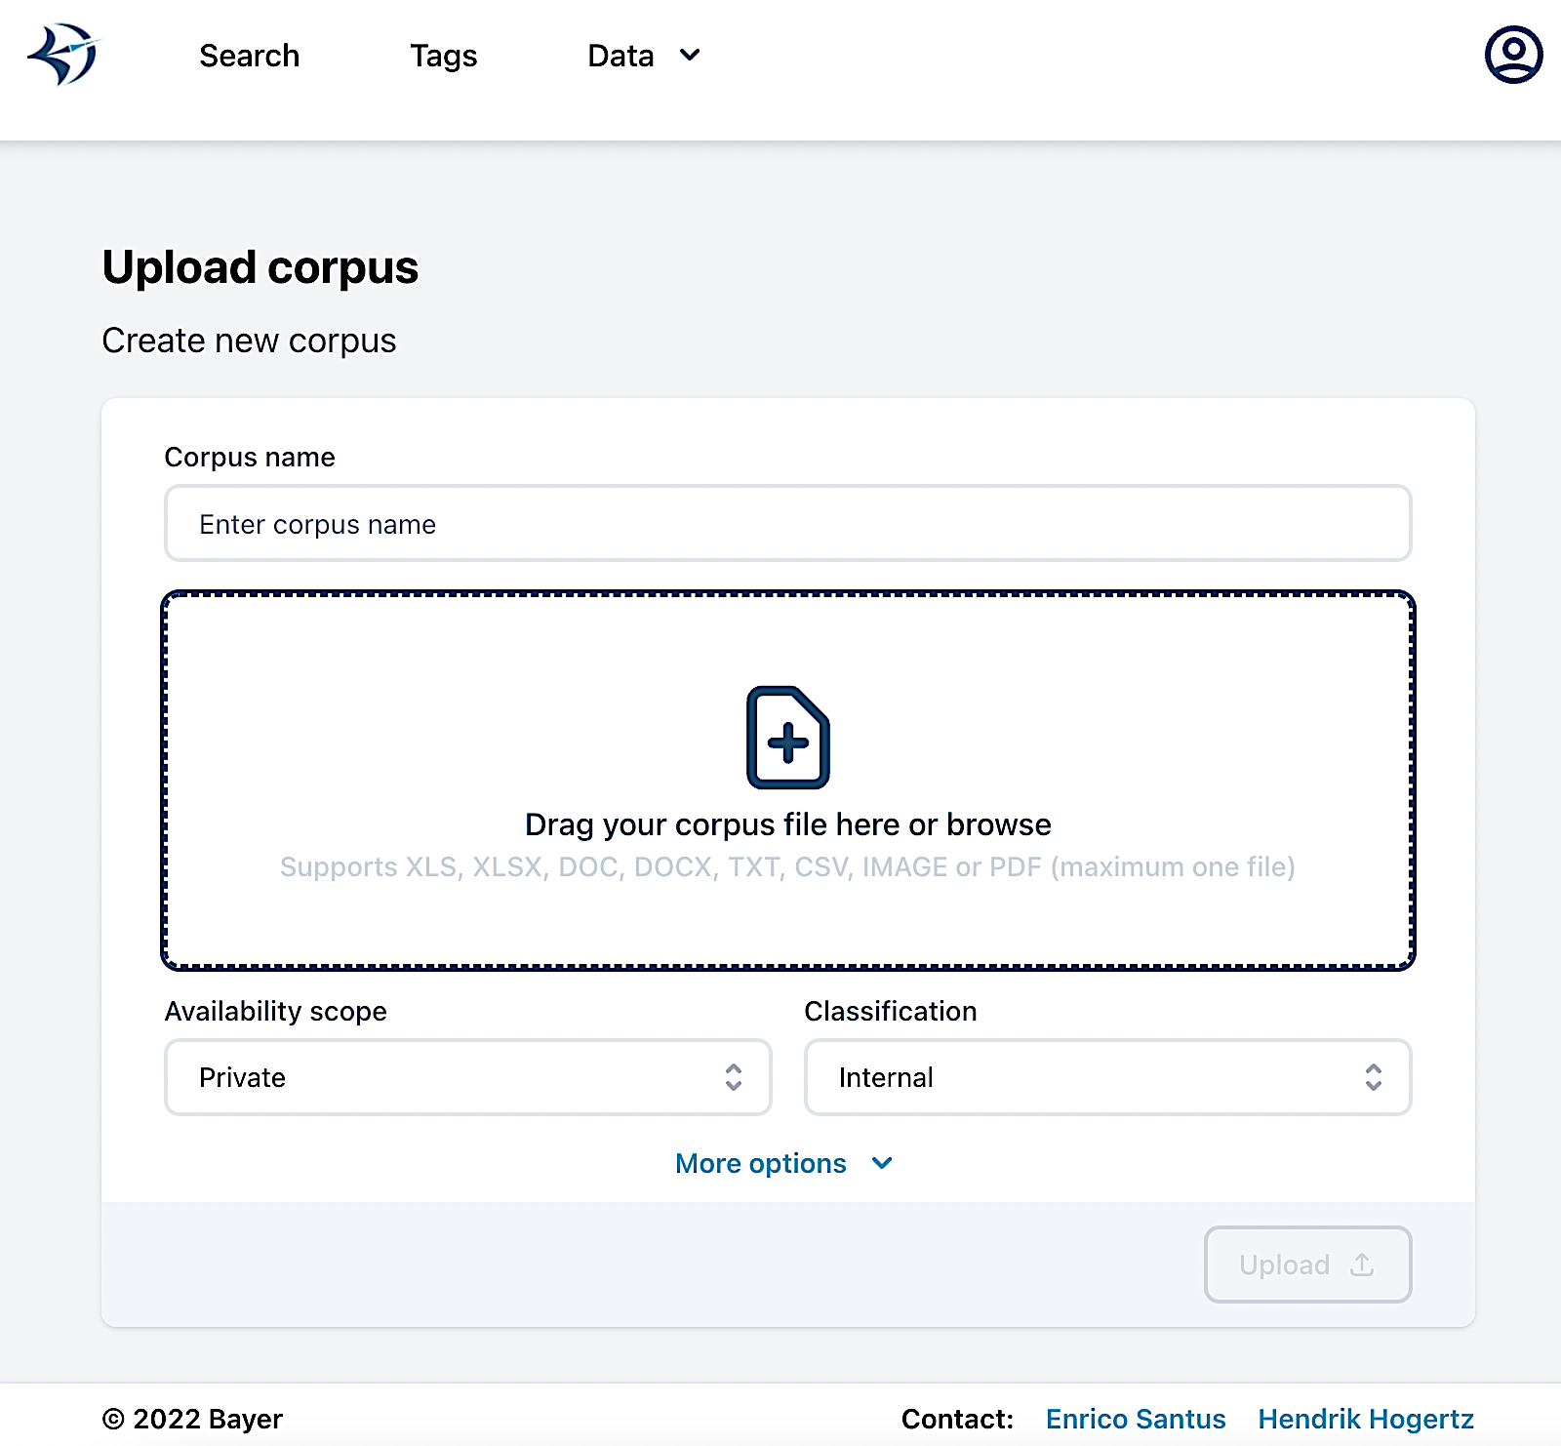



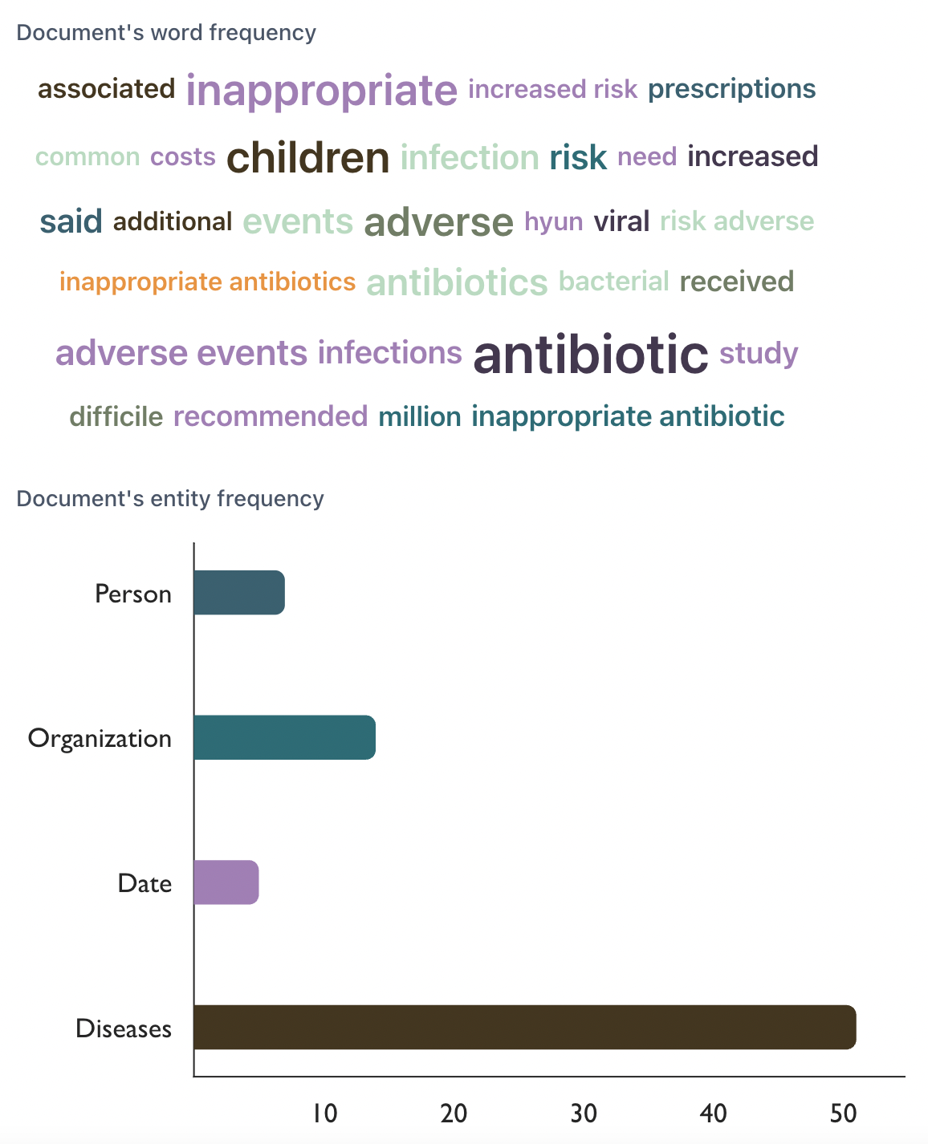
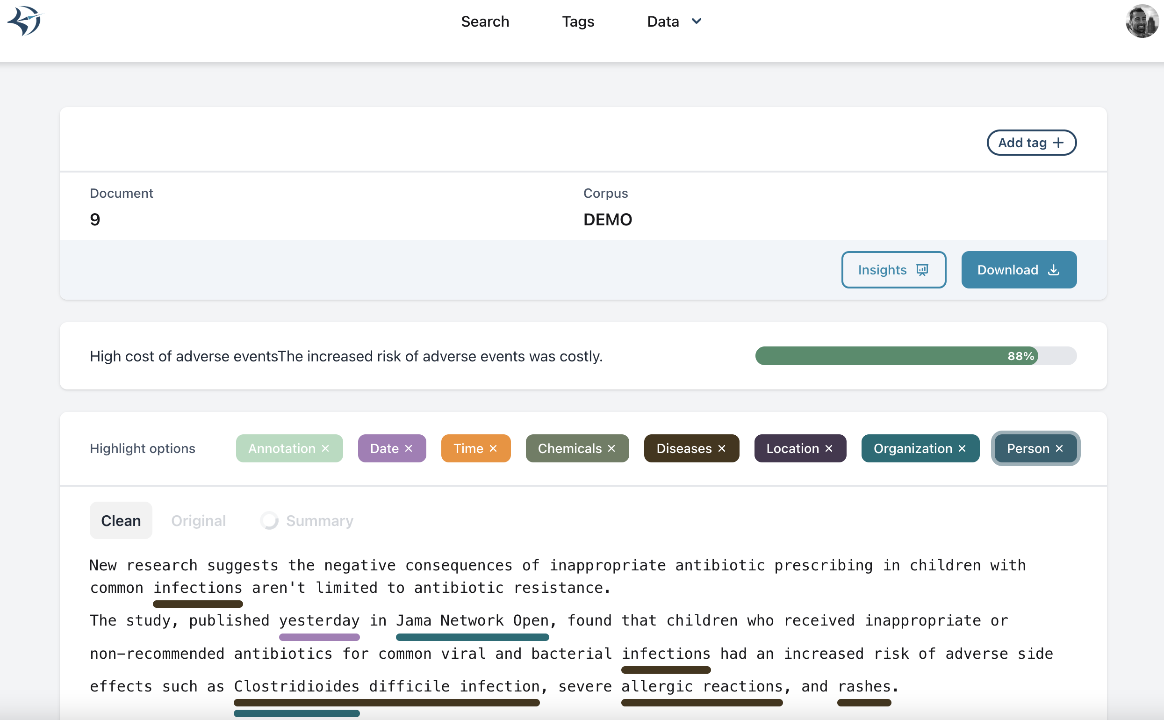

Semantic Search application that I worked
CORPUS UPLOAD
QUERY
USER
ANNOTATIONS / TAGS
SHARING
MINED QUERY RESULTS
STORAGE

Slide 3
Combining semantic and keyword search together
Search Results:
The headache lasted over a week. Jessica is suffering from
Migraine.
Query: headache
Semantic Search
Understand the meaning of queries without using a dictionary
Innovation: Combined smart search
Keyword Search
Find documents with matching keywords
Search Results: The headaches lasted over a week. The haedache is still ongoing.
Query: “headache”

Slide 4
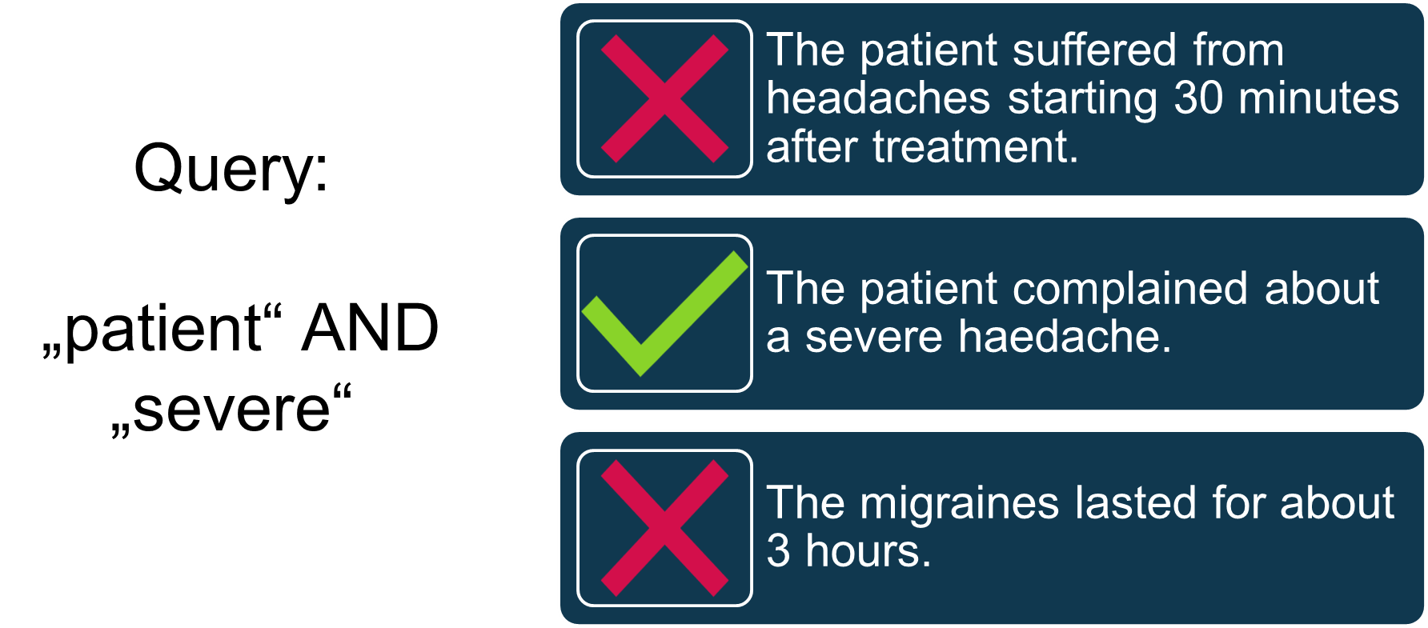
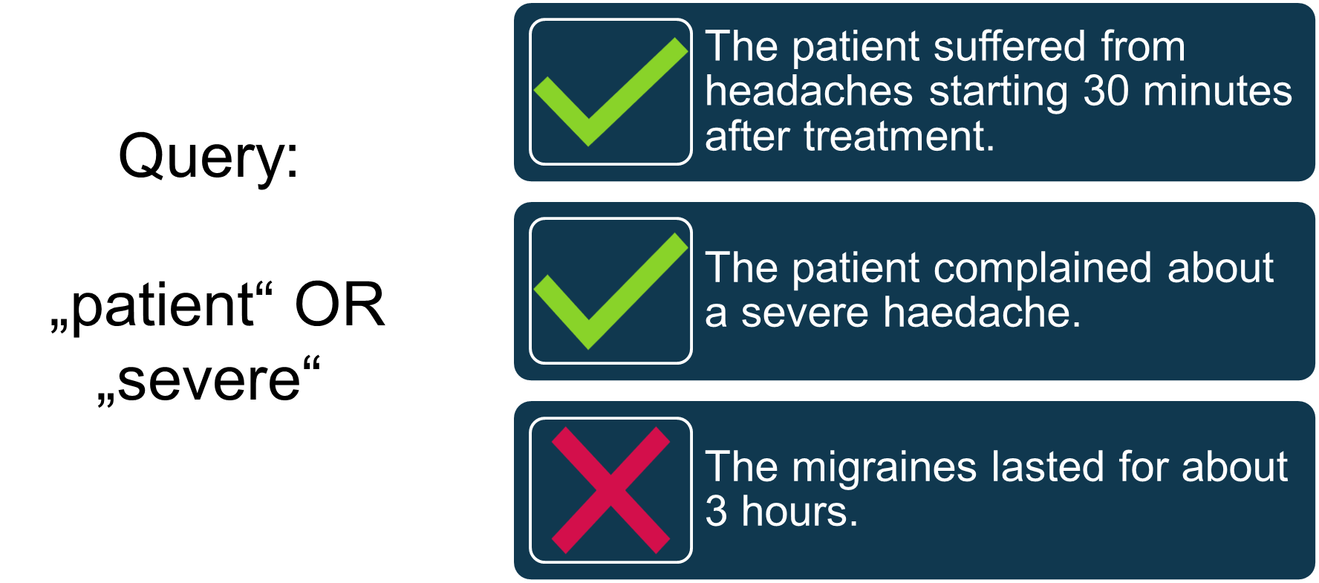
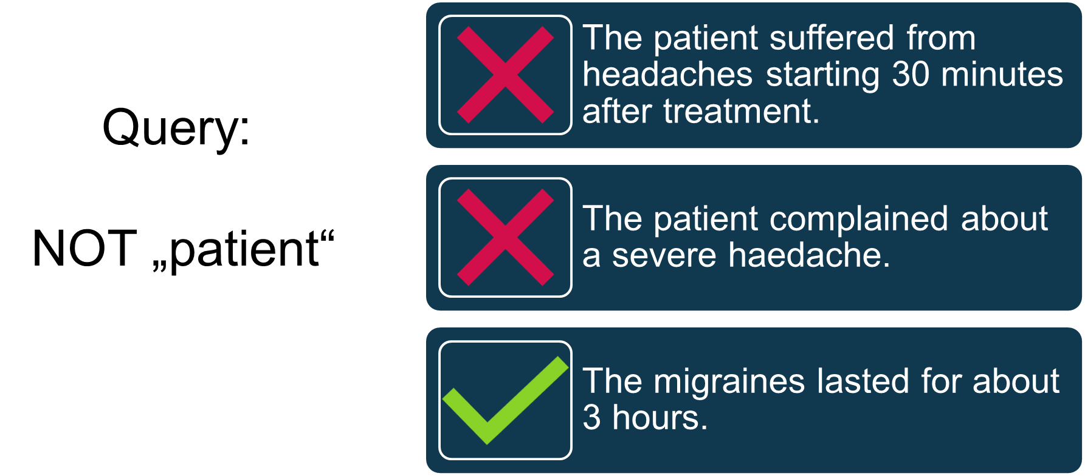
Addition of Boolean logic
AND: Result is the intersection of all matches
OR: Result is the union of all matches.
NOT: Used to negate/invert any match

Slide 5
POC on RAG pipeline
Sample Questions (Pregnancy and Lactation)
I have a patient with gross diabetic macular orders, and high risk proliferating diabetic retinopathy. She is in her second trimester of pregnancy. Do you have any safety data on usage in pregnancy.
I am just enquiring on behalf of( see add iden info) if you have any safety data for Eylea in regards to pregnant women who are in the 1st or 2nd trimester. Or if you have any safety data on pregnant women or women who intend to become pregnant.
Any information relating to the use of aflibercept in DME in breastfeeding mother (Internal Note: PI has already been provided to HCP. Please investigate whether there is a standard response available to provide any further information on this topic).
Can I please request that you provide any information on the use of Eylea during pregnancy for DMO and all other indications if available
Phone question from a doctor: can Eylea be used in a breastfeeding patient?
I have a question about Eylea (aflibercept) before starting a pregnancy, as the product summary states that effective contraception should be used during treatment and at least three months after the last injection. What is the three months based on? Is it assumed that aflibercept will remain in the body for three months after the last injection, or is there some other basis for this wording? If you have more information, I would be happy to receive it.

Slide 6
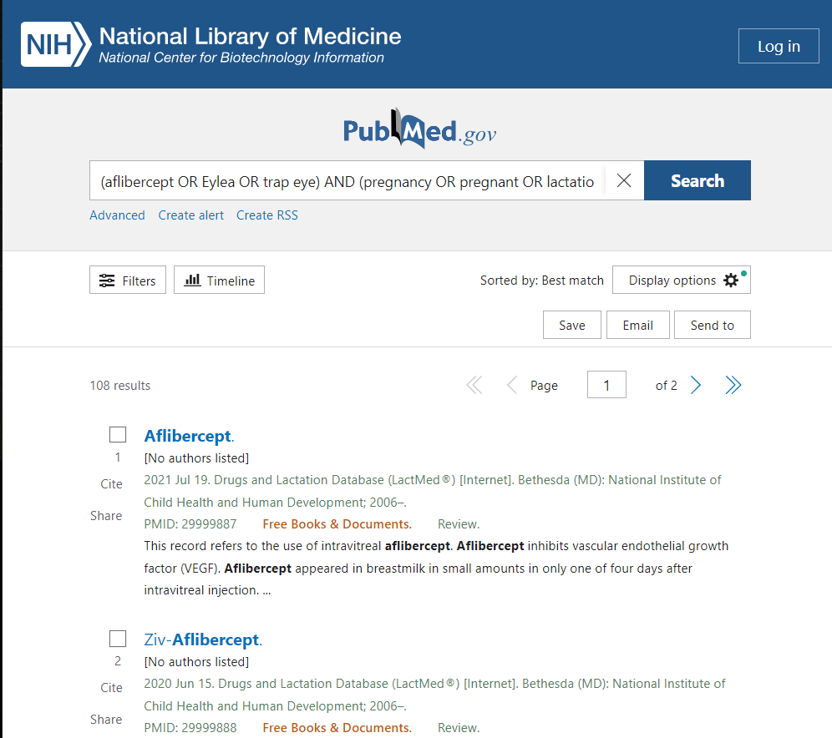
Formulate search strategy in PubMed
(aflibercept OR Eylea OR trap eye) AND (pregnancy OR pregnant OR lactation OR lactating OR nursing OR "breast" OR embryo OR fetus)
Identify relevant publications

Slide 7

Answer Questions with the help of ChatGPT & Semantic Search Workflow
Faiss Index (Document Store)
Pubmed Articles (6M)
Search Question
RoBERTa*
Vectorized Question
RoBERTa*
Most similar articles
Answer
*The RoBERTa model used here is fine-tuned with PubMed articles.

Slide 8
Example
Question: Any information relating to the use of aflibercept in DME in breastfeeding mother (Internal Note: PI has already been provided to HCP. Please investigate whether there is a standard response available to provide any further information on this topic).
Top 5 Articles suggested by the RoBERTa model
PMID | Title
26907516 | Aflibercept for the treatment of diabetic macular edema.
28427067 | Intravitreal Aflibercept in Diabetic Macular Edema: Long-Term Outcomes.
24379921 | Vascular endothelial growth factor trap-eye (Aflibercept) for the management of diabetic macular edema.
29077188 | Aflibercept in the Treatment of Diabetic Macular Edema: A Review and Consensus Paper.
26273198 | The role of aflibercept in the management of diabetic macular edema.
ChatGPT answer: There is limited information on the use of aflibercept in breastfeeding mothers. While the prescribing information has been provided to healthcare providers, there does not appear to be any standard response available for further information on this topic. Aflibercept is an anti-VEGF agent used to treat diabetic macular edema (DME) that has been shown to be effective in several clinical trials. Its use is an exciting new addition to the current VEGF antagonists available for the treatment of DME, but further studies are needed to confirm its role, safety, and efficacy. Consensus has been reached among experts on the role of aflibercept in DME, and it has been shown to be safe and effective. However, more research is needed to determine its safety and efficacy in breastfeeding mothers specifically. It is important to consult with a healthcare provider before using any medication while breastfeeding.

